Slide 1
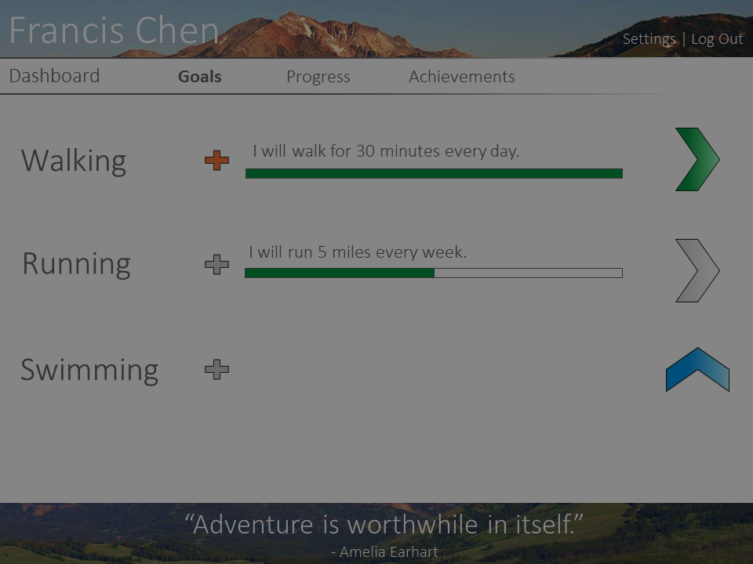
Walking
I will walk for 30 minutes every day.
I will do this exercise for
this many
seconds
every
day
Add Goal
.

